Slide 1
Experts in Cases Involving Built Facilities
Construction Defect and Premise Liability
February 2, 2014 - Winter 2014 MDLA
Presented by: Matthew D. Sloneker, Esq. & Stefan D. Helgeson, AIA, ASLA

Slide 2
So You Need An Expert…
Construction Defect or Premises Liability?
Engineer or Architect?
Egghead or experienced contractor?
Forensic specialist or likeable actor?

Slide 3
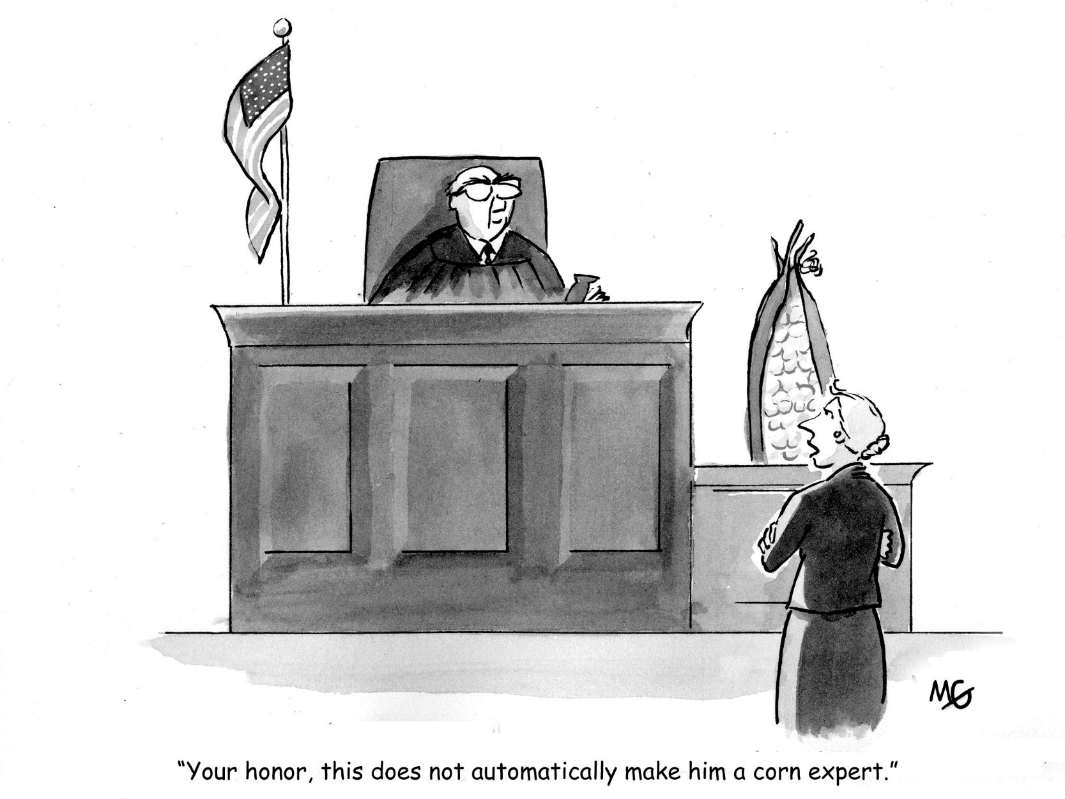

Slide 4
Construction Defect Claims
Statutory Liability: § 327A New Home Warranties
1-Year Warranty – defects caused by faulty workmanship or defective materials due to noncompliance with building standards
2-Year Warranty - defects caused by faulty installation of plumbing, electrical, heating, and cooling systems due to noncompliance with building standards
10-Year Warranty - major construction defects due to noncompliance with building standards
Minn.Stat. §327A.03 Exclusions (selected)
The liability of the vendor … does not extend to the following:
(e) loss or damage from normal shrinkage caused by drying of the dwelling….within tolerances of building standards;
(j) loss or damage from failure to maintain the dwelling … in good repair; or
(k) loss or damage which the vendee or the owner, whenever feasible, has not taken timely action to minimize.

Slide 5
Construction Defect Claims
Statutory Liability: § 327A Home Improvement Warranties
1-Year Warranty - defects caused by faulty workmanship or defective materials due to noncompliance with building standards
2-Year Warranty - defects caused by faulty installation of plumbing, electrical, heating, and cooling systems due to noncompliance with building standards
10-Year Warranty - major construction defects due to noncompliance with building standards
1-Year Warranty - defects caused by faulty workmanship or defective materials due to noncompliance with building standards (for home improvements not involving major structural changes or additions)

Slide 6
Construction Defect Claims
Statutory liability: Minnesota Common Interest Ownership Act (MCIOA)
§ 515B.4-112 Express Warranties
Affirmations of fact or promises
Models and descriptions of physical characteristics
Descriptions of quantity or extent of real estate
Representations in plats or surveys

Slide 7
Construction Defect Claims
Statutory liability: MCIOA
§ 515B.4-113 Implied Warranties
Property suitable for ordinary uses
Improvements free from defective materials and constructed in accordance with applicable law, including sound engineering and construction standards and in a workmanlike manner
Residential use will not violate applicable law

Slide 8
Construction Defect Claims
Breach of Contract
Compliance with plans and specifications
Defects in materials or workmanship
Insurance procurement and indemnity obligations

Slide 9
Construction Defect Claims
Common law obligations
Duty to use reasonable care
Implied covenant of good faith and fair dealing
Promissory estoppel
Respondeat Superior
Owner/Developer implied obligations
Disclose material information
Provide accurate plans & specifications (Spearin Doctrine)
Obtain permits, approvals, and easements
Timely review submittals and requests
General Contractor’s implied obligations
Build per plans, specifications and codes
Workmanlike construction: of good quality, free of defects, conformed to contract documents

Slide 10
Premises Liability Claims
Duties owed by Property Owner
General duty to use reasonable care for the safety of all such persons invited upon the premises
Duty exists whether entrant is a licensee or an invitee
Duty is not absolute – landowners are not insurers of an entrant’s safety
Other factors in determining scope of duty owed:
Duty is modified according to the expected use of the land
Foreseeability or possibility of harm
Ongoing duty to inspect and maintain property to ensure entrants are not exposed to unreasonable risk of harm
Duty to repair or warn (If condition discoverable through reasonable efforts)
Entrant also owes duty of reasonable care in ensuring his own safety

Slide 11
Whom are You Representing?
Construction Defect and Premise Liability
Owner – HOA
Developer
Tenant
General Contractor / Construction Manager
Sub-contractor
Supplier / Sub to Sub-contractor
Architect / Engineer
Sub-consultant to Architect / Engineer
Other Parties

Slide 12
Are you asserting affirmative claims?
Claims Against Professionals - Minn. Stat. § 544.42 Requirements
Applies to attorneys, architects, certified public accountants, engineers, land surveyors, landscape architects, and others licensed under Minn. Stat. Sections 326 or 326A
Define applicable standard of care
Opine that defendant deviated from standard of care
Causation of damages

Slide 13
Expert’s Ability to Opine on a Standard of Care
Who can testify as an expert - Minn. R. Evid. 702
If scientific, technical, or other specialized knowledge will assist the trier of fact to understand the evidence or to determine a fact in issue, a witness qualifed as an expert by knowledge, skill, experience, training, or education, may testify thereto in the form of an opinion or otherwise. The opinion must have foundational reliability. In addition, if the opinion evidence involves novel scientific theory, the proponent must establish that the underlying scientific evidence is generally accepted in the relevant scientific community.

Slide 14
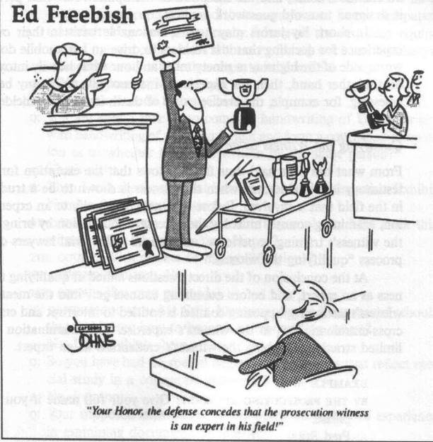

Slide 15
Expert’s Ability to Opine on a Standard of Care
Industry Standard of Care
Construction defect claims
Often against general and/or subcontractor
Technical / industry background, education and experience
Ability to opine on the represented parties’ duties – G.C., sub-contractor, suppliers, etc.
Familiarization with standards and codes
Often deals with discussion of “workmanlike construction”, defined as:
Good quality, free from defects and in conformance with contract documents

Slide 16
Expert’s Ability to Opine on a Standard of Care
Professional Standard of Care
Education and Licensure (Minnesota Board of AELSLAGID)
Architects – building type and use specialization, types of experience as a project manager, project architect, specification writer, other
Engineers – structural, civil, mechanical, electrical, other
Land surveyors
Landscape architects
Geoscience
Interior designers
Professional Specialties – medical, safety, human factors, insurance, accounting, real-estate, etc.

Slide 17
Expert’s Ability to Opine on a Standard of Care
Engineering Exams
Agricultural
Architectural
Chemical
Civil
Construction
Geotechnical
Structural
Transportation
Water Resources and Environmental
Control Systems
Electrical and Computer
Computer Engineering
Electrical and Electronics
Power
Environmental
Fire Protection
Industrial
Mechanical
HVAC and Refrigeration
Mechanical Systems and Materials
Thermal and Fluids Systems
Metallurgical and Materials
Mining and Mineral Processing
Naval Architecture and Marine
Nuclear
Petroleum
Software
Structural

Slide 18
Expert’s Ability to Opine on a Standard of Care
Professional Standard of Care
The accepted industry standard of care for professional architecture design and administration services is defined by the American Institute of Architects (AIA) as:
The Architect shall perform its services consistent with the professional skill and care ordinarily provided by architects practicing in the same or similar locality under the same or similar circumstances
The Architect shall perform its services as expeditiously as is consistent with such professional skill and care and the orderly progress of the Project

Slide 19
Expert’s Ability to Opine on a Standard of Care
Professional Standard of Care
“One who undertakes to render professional services is under a duty…to exercise such care, skill, and diligence as men in that profession ordinarily exercise under like circumstances.” City of Eveleth v. Ruble, 225 N.W.2d 521 (Minn. 1974).
“Engineers are not required to produce perfect results, “but rather [to] exercise…that skill and judgment which can be reasonably expected from similarly situated professionals.” Waldor Pump & Equip. Co. v. Orr-Schelen-Mayeron & Assocs., Inc., 386 N.W.2d 375 (Minn. Ct. App. 1986).
The standard of reasonable care that applies to the conduct of architects is the same as that applied to lawyers, doctors, engineers and other professionals engaged in furnishing skilled services for compensation. Gammel v. Ernst & Ernst, 72 N.W.2d 364 (Minn. 1955).

Slide 20
Expert’s Ability to Opine on a Standard of Care
Failure to Define Standard of Care
Developer’s claims against design engineering company dismissed for failure of experts to establish standard of care – Pond Hollow Homeowners Ass’n v. The Ryland Group, Inc., 779 N.W.2d 920 (Minn. Ct. App. 2010).
Failure to Substantiate Qualifications
Expert offered in support of claims against professional must “make a substantial showing of qualification in the particular field of inquiry.” Swanson v. Chatterton, 160 N.W.2d 662, 669 (Minn. 1968).

Slide 21
Expert’s Ability to Opine on a Standard of Care
Expert may also need practical experience in the particular matter at issue
Law professor with only academic experience not qualified to opine on standard of care applicable to criminal defense attorney – Noske v. Friedberg, 713 N.W.2d 866 (Minn. Ct. App. 2006).
Psychologist without practical experience not competent to give opinion on standard of medical care or departure therefrom – Lundgren v. Eustermann, 370 N.W.2d 877 (Minn. 1985).
Expert may also be qualified due to related experience
Professional estimator and certified engineering technician qualified to opine on standard of care of architect based on experience. Prichard Bros., Inc. v. Grady Co., 436 N.W.2d 460 (Minn. Ct. App. 1989).

Slide 22
Expert’s Ability to Opine on a Standard of Care
Qualification challenges based on methodology, testing
Frye-Mack
General acceptance in relevant scientific community
Scientifically reliable foundation of evidence derived from testing
Daubert
“General acceptance” standard superseded by Fed. Rules of Evidence
Is reasoning or methodology scientifically valid?
Can reasoning or methodology be properly applied to facts?
Has theory or technique been tested, subjected to peer review & publication?
Must assist trier of fact (i.e., relevance)

Slide 23
Investigation Background and Methodology
Construction Defect - Documents
Contracts between all parties
Contract Documents including code review, plans and specifications from time of construction
Project files including meeting minutes, emails, submittals / shop drawings / RFI’s / ASI’s / Change Orders
City site documents including planning and zoning approvals, correspondence and staff reports
City building documents including signed and approved Contract Documents (A, C, M, E, P, S) with city comments and notations, permits, inspections, and CO

Slide 24
Investigation Background and Methodology
Premise Liability (slip/trip and fall) - Documents
Contract Documents including code review and plans and specifications from time of original construction or most recent addition / remodel
Maintenance records, procedures, products and schedules
Reports of any previous incidents
Contracts and invoices with maintenance providers
City documents, inspections and correspondence

Slide 25
Investigation Background and Methodology (Cont.)
Standard of care for involved parties – technical / industry and professional
Notifications
Destructive and non-destructive inspections
Previous invasive inspections by plaintiff’s experts
Reliance of discovery by others
Observation and documentation of process
Expert disputes on methodology in the field
Acquiring and preserving artifacts
Sign off by responsible party
Compliance with ASTM standards E-1492 including chain of custody

Slide 26
Seven Steps of the Scientific Method – NFPA 921
Recognize the problem (Identify)
Define the problem
Collect data
Analyze the data
Develop a hypothesis (inductive reasoning)
Test the hypothesis (deductive reasoning)
Select the final hypothesis

Slide 27
Defense Opinions
Simply respond to claims against client or point the finger at others?
Address issues not raised by opposing expert or let them lie?
Address industry or professional standard of care or both?
What defense arguments are you making?
We followed applicable industry standards and codes at time of construction or incident?
We complied with Contract Documents?
We met standard of care of similarly situated professional?
We relied on other parties?

Slide 28
Thank You!

Slide 29
Case Study: Premise Liability Slip & Fall

Slide 30
Premise Liability Case Study
Slip and Fall
At 5 a.m. on a winter workday in downtown St. Paul, Elderly Irish business client, Sir Rowan O’Rooney:
Parked on the highest level of a nearly vacant downtown parking ramp
Proceeded down the 5 levels of the ramp stair to the street level
Walked ½ block over snowy and icy sidewalks
Proceeded through a plaza area in front of the building and main floor lobby area of a large commercial high-rise
Climbed the steps of a non-operating escalator to the skyway level
Walked over a short section of wet carpet that had just been shampooed
Through a set of double doors into an elevated skyway section over the street.
Floor of the skyway was of terrazzo finish, slightly inclined away from his direction of travel.
Skyway was lit with artificial lighting and was slightly heated.

Slide 31
Premise Liability Case Study
Incident
At mid-section of the skyway:
Left foot slipped forward
Tried to resist the fall
Grabbed for a section of railing along the side of the ramp
The railing pulled loose
Causing Sir Rowan to fall on his back.
He suffered multiple fractures and emotional pain and trauma.
Claims exceeded at least $5M.

Slide 32
Premise Liability Case Study
Slip and Fall
Sir Rowan alleged that his injuries were a direct cause of:
Poor signage caused him to park in the upper level of a ramp that was too far from the building entrance
Walk outdoors on poorly maintained sidewalks and outdoor plaza area in front of the building
A cold lobby area
A non-operating escalator
Wet carpet
Double doors that were difficult to push open
A cold skyway
A skyway floor that was overly sloped, slippery and poorly lit.

Slide 33
What experts would be necessary to either advance and defend a claim for damages due to injuries?
Medical - injuries
Architects - architectural elements including the location of the ramp from the main building, lobby and skyway design compliance to codes
Chemists - floor surface finishes, maintenance products used for cleaning and mopping and carpet cleaning,
Human factors - incident factors and fall dynamics
Maintenance - reasonable operation of building escalators
Wayfinding - building and ramp signage
Forensic video technicians - record the number of building occupants that use the skyway on a daily basis

Slide 34
What experts would be necessary to either advance and defend a claim for damages due to injuries?
Engineers
Civil – ramp design and traffic signage
Electrical - lighting levels compliance to codes
Mechanical HVAC - temperature of the lobby and skyway areas compliance to codes
Mechanical Systems- door operation and closure functions, resistance and compliance to codes
Mechanical Testing – dry and wet static dynamic coefficient of friction measurements of the floor area utilizing Binary Output Tribometer (BOT) testing
Materials - condition, strength and attachment mechanism of the railing
Structural - railing strength compliance to codes
Safety - maintenance and safety warnings

Slide 35
What are the necessary documents?
Contract documents
Plans and specifications for the building and ramp from time of original construction or most recent addition / remodel
Railing shop drawings
Signage shop drawings
Maintenance and testing records
Procedures, schedules
Product information including MSDS’s of all maintenance materials and products used for the floor and carpet maintenance
Door closures, escalator and moving equipment
Vendor contracts and invoices
Operation records
Escalator
Heating and cooling of the building lobby area and skyway
Reports of any previous incidents
City documents
Inspections and correspondence, maintenance records of the sidewalks

Slide 36
Crane Engineering Building Science
We answer clients’ questions regarding defects and failures in building design, construction and materials – and how they can be prevented or resolved.
Disciplines
Architecture
Structural Engineering
Fire Protection Engineering
Mechanical, HVAC and Plumbing Systems
Electrical Engineering
Landscape Architecture
Civil & Geotechnical Engineering
Services
Codes and Contract Review
Building Component Analysis
Building Design and Reconstruction
Types of Buildings
Retail and commercial
Industrial and manufacturing
Institutional
Residential – single and multifamily

Slide 37
Thank You!

